Slide 1

ELECTRIC FIELDS
A Shocking Development… Let’s Zap Through It!

Slide 2
ELECTRIC FIELD LINES
We have dealt with field lines before, when we discussed gravity. Gravity is a fundamental force – so is electromagnetism. We’ll discuss the ‘magnetism’ part of electromagnetism another time; for now, we are going to discuss electric fields.
Electric fields exist in the space around charged particles. They indicate a force exerted on neighbouring charged particles within the vicinity.
Let’s go over the rules for drawing electric field lines, as presented in your books.

Slide 3

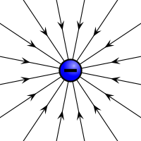
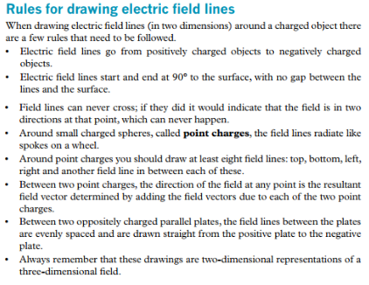
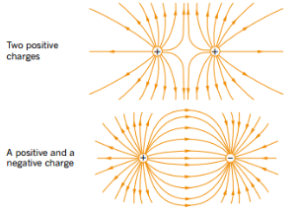
ELECTRIC FIELD LINES

Slide 4

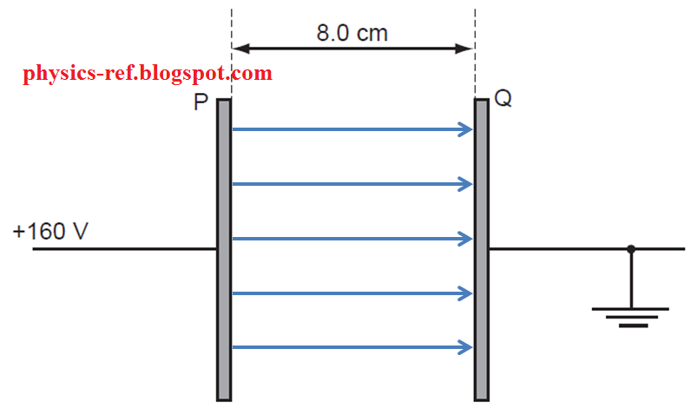
ELECTRIC FIELD LINES
The electric field between two charged plates looks thus:
One plate is charged, the other is earthed (i.e. potential = 0). Electric field still possible due to the one charged plate.

Slide 5
ELECTRIC FIELD LINES
Recall that, when it comes to charged particles, the rule is ‘opposites attract’ (and like-charges repel).
The only way to detect an electric field is to observe its’ effect on a charged particle, called a ‘test-charge’.
One way to recall the proper direction of electric field lines is to realise that the direction of the field lines tells us the direction of the resultant force on a positively-charged test particle (the resultant force on a negatively-charged test particle is simply the opposite direction).

Slide 6
TEST CHARGE
+
+
+
-

Slide 7
TEST CHARGE
-
-
-
+

Slide 8
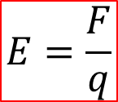
ELECTRIC FIELD STRENGTH
Charged particles entering an electric field experience a force. The magnitude of that force depends upon the size of the charge entering the electric field, and the strength of the electric field itself.
Recall that Gravitational Field Strength, which is dependent on mass, is measured in N kg⁻¹. Well, Electric Field Strength, which is dependent on charge, is measured in N C⁻¹ (Newtons per Coulomb).
Force (N)
$$E=\frac{F}{q}$$
Electric Field Strength (N C⁻¹)
Charge (C)

Slide 9

FORCE ON A CHARGED PARTICLE
Rearranging the equation for field strength, we get an equation for the force experienced by a charged particle entering an electric field.
$$F=Eq$$

Slide 10
EXAMPLES
Q: An electric field causes an electron to experience a force of magnitude 8.00 x 10⁻²⁰ N. Find the strength of the field:
A: E = F/q = (8.00 x 10⁻²⁰) / (1.60 x 10⁻¹⁹) = 0.50 N C⁻¹.
Q: An alpha particle passes through an electric field of 0.25 N C⁻¹. Find the magnitude of the subsequent force acting on the particle:
A: F = Eq = (0.25) x (2 x 1.60 x 10⁻¹⁹) = 8.00 x 10⁻²⁰ N.
Q: A neutron passes through an electric field of 0.93 N C⁻¹. Find the magnitude of the subsequent force acting on the particle:
A: Neutrons have no charge, so it does not experience any force due to the electric field.
Notes:
*For the first value, we’re really only interested in the MAGNITUDE of the values here, so we tend to ignore the sign of the charge. For the second example, sign does matter as it gives us direction of the force (i.e. with field lines or against them; negative = against).

Slide 11
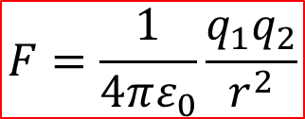
COULOMB’S LAW
We now know that, not only do charged particles generate electric fields, but charged particles entering an electric field (not their own) will experience a force. Logically, we can conclude that charged particles will each exert a force on the other when they pass near to one another. To calculate this force, we use Coulomb’s Law:
Force (N)
Charges (C)
$$F=\frac{1}{4πε_{0}}\frac{q_{1}q_{2}}{r^{2}}$$
Permittivity of Free Space (8.85 x 10⁻¹² C² N⁻¹ m⁻²)
Distance between charges (m)
*Called the ‘Electric Constant’ on your Data Sheet

Slide 12

THE ‘ELECTRIC CONSTANT’
$$ε_{0}$$
The ‘Electric Constant’ goes by a number of names (we will stick to the first two):
Electric Constant
Permittivity of Free Space
Vacuum Permittivity
Dielectric Constant of a Vacuum
Distributed Capacitance of the Vacuum
Different media have their own permittivity, usually higher than that of a vacuum.

Slide 13

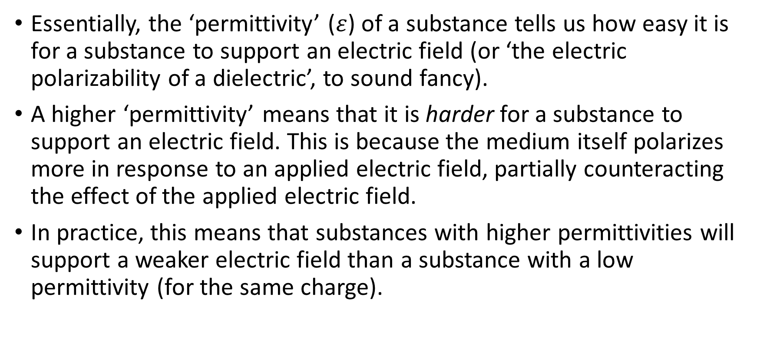
THE ‘ELECTRIC CONSTANT’
$$ε$$
Essentially, the ‘permittivity’ ($ε$) of a substance tells us how easy it is for a substance to support an electric field (or ‘the electric polarizability of a dielectric’, to sound fancy).
A higher ‘permittivity’ means that it is harder for a substance to support an electric field. This is because the medium itself polarizes more in response to an applied electric field, partially counteracting the effect of the applied electric field.
In practice, this means that substances with higher permittivities will support a weaker electric field than a substance with a low permittivity (for the same charge).

Slide 14
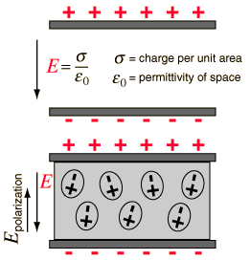
THE ‘ELECTRIC CONSTANT’
$$ε$$
Applied E
E from dielectric in response to Applied E
Dielectric (medium containing charged particles that will respond to an applied electric field)
Notes:
Dielectrics (uni-wuppertal.de)

Slide 15
THE ‘ELECTRIC CONSTANT’
$$ε$$
-
-
Same Charge
Different Field Strength
Substance with Low ε
Substance with High ε

Slide 16
THE ‘ELECTRIC CONSTANT’
$$ε$$
You are not expected to recall the definition for the electric constant, only to use it in equations (i.e. Coulomb’s Law).
However, there have been past exam questions (Section 3 Questions) involving permittivity, so a little discussion about it is worthwhile.
The permittivity of free space will make a (brief) reappearance next semester… for now, we’ll say no more about it.
Let’s get back to Coulomb’s Law!

Slide 17



COULOMB’S LAW
Notice that the first part of Coulomb’s Law is actually all constant values.
Often, this expression is replaced with a single value – the ‘Coulomb Constant’ ‘k’, where k ≈ 9.00 x 10⁹ N m² C⁻² :
Look familiar?
$$F=\frac{1}{4πε_{0}}\frac{q_{1}q_{2}}{r^{2}}$$
$$F=k\frac{q_{1}q_{2}}{r^{2}}$$
$$F=G\frac{m_{1}m_{2}}{r^{2}}$$

Slide 18





ELECTRIC FIELD STRENGTH
We have two expressions for the force on a charged particle:
By setting them equal to each other, we can find an expression for the strength of the electric field around a charged particle, dependent only on the charge itself and the distance from the charge:
Look familiar?
$$F=Eq$$
$$F=k\frac{Qq}{r^{2}}$$
$$Eq=k\frac{Qq}{r^{2}}$$
$$→E=\frac{kQ}{r^{2}}$$
$$g=\frac{GM}{r^{2}}$$

Slide 19
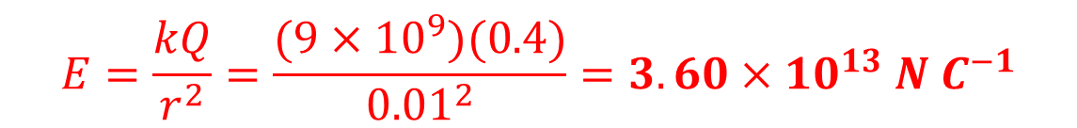
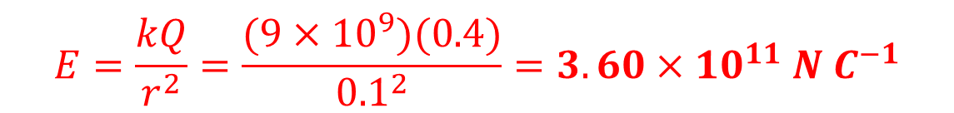
EXAMPLES
Q: Find the electric field strength of a point-charge of 0.40 C at a distance of:
1 cm?
10 cm?
$$E=\frac{kQ}{r^{2}}=\frac{(9×{10}^{9})(0.4)}{{0.01}^{2}}=3.60×{10}^{13} N C^{−1}$$
$$E=\frac{kQ}{r^{2}}=\frac{(9×{10}^{9})(0.4)}{{0.1}^{2}}=3.60×{10}^{11} N C^{−1}$$

Slide 20
EXAMPLES
Q: Find the force between two protons separated by a distance of 0.001 m:
Q: Find the force between a proton & an electron separated by a distance of 0.001 m:
Notice: Attractive Force = ‘-’ve, Repulsive Force = ‘+’ve.
$$F=\frac{kQq}{r^{2}}=\frac{(9×{10}^{9})(1.60×{10}^{−19})(1.60×{10}^{−19})}{{0.001}^{2}}=2.30×{10}^{−22} N$$
$$F=\frac{kQq}{r^{2}}=\frac{(9×{10}^{9})(1.60×{10}^{−19})(−1.60×{10}^{−19})}{{0.001}^{2}}=−2.30×{10}^{−22} N$$
Notes:
*Sign matters here.

Slide 21
TRY IT YOURSELF!
A proton, with initial velocity of 0.03 m/s, passes through the electric field below, entering the field equidistant from the plates. The field strength is 4.00 x 10⁻¹⁰ N C⁻¹. The length of the field is 10 cm, and the plates are 5 cm apart. Find the final velocity of the proton. Does the proton hit the bottom plate? (Ignore gravitational effects):
0.05 m
+
0.03 m/s
0.10 m
Notes:
1. F=Eq = 6.4x10^-29 N. Time to get to end of plate = s/v = 3.33 seconds. a(down) = F/m = 3.83x10^-2 m/s/s. Time to ‘fall’ 2.5 cm = 1.14 seconds, therefore yes, will hit bottom plate. Final vertical velocity, therefore, is 4.38x10^-2 m/s. Using Pythagoras & SOH CAH TOA, final velocity is 5.31x10^-2 m/s at 55.6˚ from the plate.

Slide 22
TRY IT YOURSELF!
An electron passes through an electric field without deviating. What is the magnitude and direction of the electric field? (Do not ignore gravity).
Two identical charged spheres of mass 0.5 g are suspended motionless from a 1.00 m string. The spheres are 4.00 cm apart. Find the charge on the spheres. (Tricky! Try drawing the forces acting on each sphere…).
1.00 m
1.00 m
+
+
4 cm
Notes:
2. Field lines must be pointing DOWN (as this would make electron accelerate upwards, countering gravity). Fe = Fg, so Eq = mg, rearranging E = mg/q = 5.58x10^-11 N/C.
3. Draw forces Fe, Fg & T. Then, draw two triangles – a vector triangle and a geometric triangle; these are similar triangles, so the angles are the same. Use them both to make two different expressions for one of the common angles (i.e. use tan theta), and equate these expressions to each other, substituting formulas for Fg & Fe. Rearrange and solve for Q (charge) – should get 4.2 nC (4.17x10^-9 C). See here for solution: http://physicstasks.eu/1551/charged-balls-hanging-on-a-string

Slide 23

ELECTRIC FIELD STRENGTH
There is another way to work out electric field strength; if we have two points in an electric field, separated by a distance ‘d’ that is parallel to the field lines, with a potential difference between them (i.e. a voltage, ∆V), then our equation becomes:
The units here become Volts-per-meter (V m⁻¹).
These units are equivalent to N C⁻¹ – they are interchangeable.
$$E=\frac{V}{d}$$
∆V
d
Notes:
*Useful for charged plates.

Slide 24



ELECTRIC FIELD STRENGTH
We now have two equations for electric field strength.
We can equate them together:
This can be useful for solving certain questions.
$$E=\frac{V}{d}$$
$$E=\frac{F}{q}$$
$$\frac{F}{q}=\frac{V}{d}$$
Notes:
*Useful for charged plates.

Slide 25
EXAMPLES
Q: An electron enters an electric field of 1000 V/m. Find the force acting upon the electron.
$$E=\frac{V}{d}=1000 Vm^{−1}=1000 NC^{−1}=\frac{F}{q} ,$$
$so F=1000×q=1000 \left(−1.60×{10}^{−19}\right)=$ $−1.60×{10}^{−16} N$
Notes:
*Useful for charged plates.

Slide 26
EXAMPLES
Q: An electron travels 10 cm between two parallel charged plates. Between the plates is a uniform electric field strength of 25 N C⁻¹. Find the potential difference between the plates.
$$E=\frac{V}{d}→V=Ed=25\left(0.10\right)=2.50 V$$
∆V
Notes:
*Useful for charged plates.

Slide 27


ELECTRIC FIELD STRENGTH
Suppose we shift this equation around ever so slightly…
Now it becomes…
Look at the top line of that fraction. What is that called?
$$\frac{V}{d}=\frac{F}{q}$$
Answer: Force times distance equals work (i.e. energy)!
$$V=\frac{Fd}{q}$$

Slide 28

WORK DONE IN AN ELECTRIC FIELD
You may recall from Year 11 Physics that Voltage is the measure of the amount of energy per unit of charge (Joules per Coulomb, or J C⁻¹). The equation, therefore, is:
This is one of those times where notation is important; sometimes you see this equation written with an ‘E’ for ‘energy’ instead of a ‘W’ for ‘Work’; although ‘work’ and ‘energy’ are essentially synonymous, we already use ‘E’ for Electric Field Strength. Using ‘W’ for work/energy helps to avoid confusion.
$$V=\frac{W}{q}$$

Slide 29

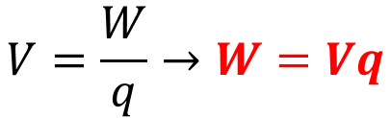
WORK DONE IN AN ELECTRIC FIELD
When a charged particle enters an electric field, the field does work on the particle. We can find out how much by rearranging the equation:
$$V=\frac{W}{q}→W=Vq$$
$$Fd=Vq$$

Slide 30
EXAMPLES
Q: An electron passes through a potential difference of 1 Volt. Find the work done to move the particle:
This should look familiar… it is the amount of energy defined by Physicists as an electron-volt (in fact, the question basically gives you the definition of an electron-volt). You have used it before (in Year 11 Nuclear Physics), and it appears in your data sheets this year also.
$$V=\frac{W}{q}→W=Vq=1\left(1.60×{10}^{−19}\right)=1.60×{10}^{−19} J$$

Slide 31
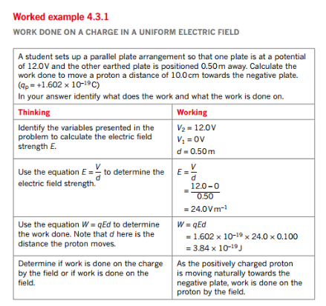
EXAMPLES

Slide 32
WORK DONE IN AN ELECTRIC FIELD
Finally, we said earlier that when a charged particle enters an electric field, the field does work on the particle. It is also possible for the particle to do work on the field; what does this mean?
Recall that we had a similar discussion about gravity…

Slide 33
WORK DONE IN A GRAVITATIONAL FIELD
When an object falls in a gravitational field (i.e. it moves with the field lines), then we say that the field is doing work on the object (i.e. work is being done by the field – energy is being released by the field to the object):
h

Slide 34
WORK DONE IN A GRAVITATIONAL FIELD
When an object rises in a gravitational field (i.e. it moves against the field lines), then we say that the object is doing work on (or against) the field (i.e. work is being done against the field – energy from the object is being stored in the field):
h

Slide 35
WORK DONE IN AN ELECTRIC FIELD
Similarly, when positive charge moves with the field lines in an electric field (or when a negative charge moves in the opposite direction), then we say that the field is doing work on the object (i.e. work is being done by the field – energy is being released by the field to the object):
+
-

Slide 36
WORK DONE IN AN ELECTRIC FIELD
When a positive charge moves against the field lines in an electric field (or when a negative charge moves with them), then we say that the charge is doing work on (or against) the field (i.e. work is being done against the field):
-
+

Slide 37
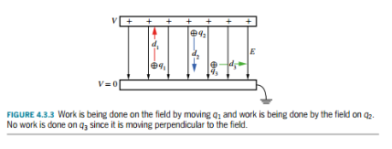
WORK DONE IN AN ELECTRIC FIELD
For work to be done, the direction of motion must be parallel to the field lines, not perpendicular.

